Slide 1
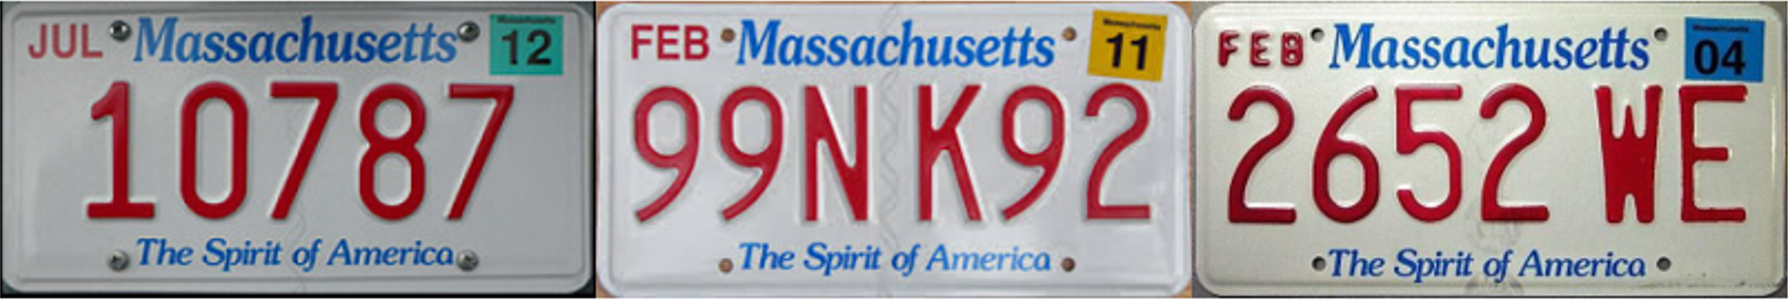
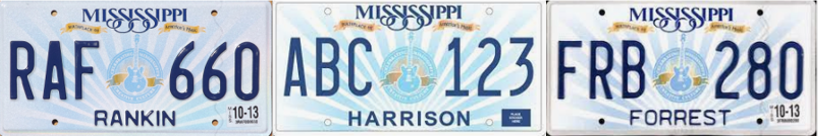
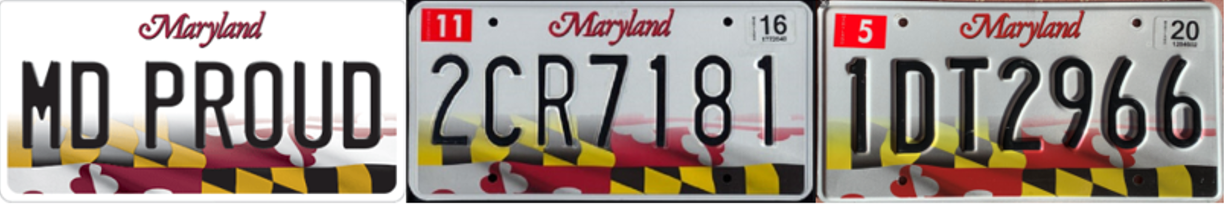
State Recognition and Serial Extraction
Format & Pattern are stable
Serial colors are consistent
Serial colors are different from the backgroud

Slide 2
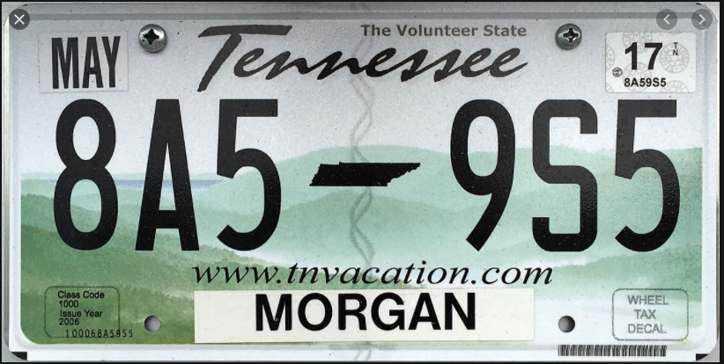
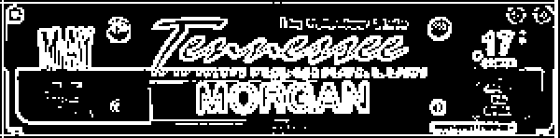
State Recognition and Serial Extraction
State features area
Edge detection & binarization
Result: TN
StateRecogCNN
Feature image

Slide 3

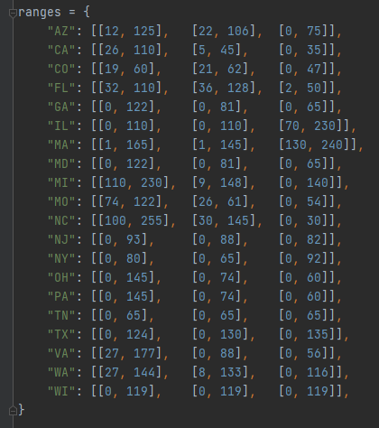
State Recognition and Serial Extraction
Serial area
TN: [[0, 65], [0, 65], [0, 65]]
Look up to
Result: TN
State-color range table

Slide 4
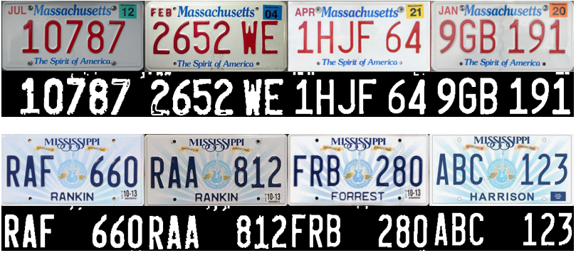
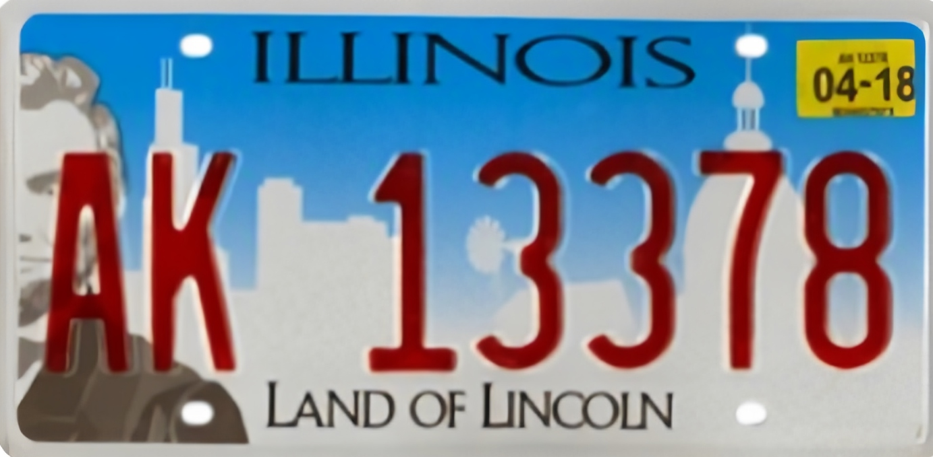

State Recognition and Serial Extraction
New and old license plates and the different illumination
Properly widened RGB range
Too-wide RGB range

Slide 6
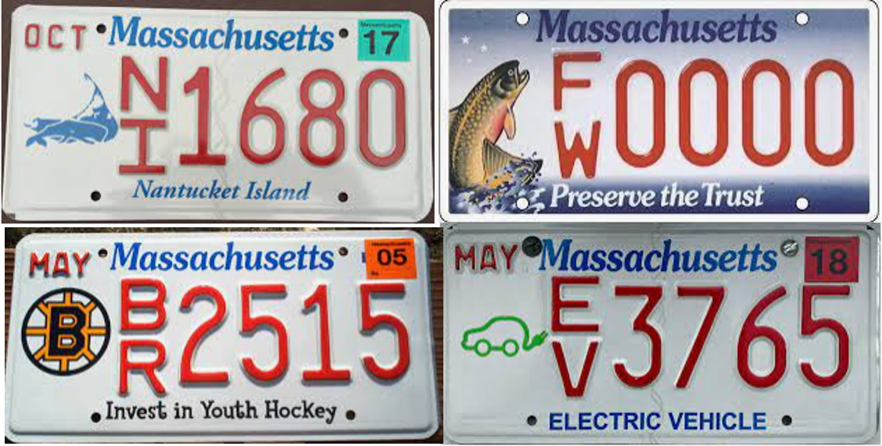
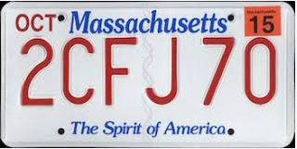
Future Work
1. Improvement of universality
- More states (currently we only deal with the top-20 states with the most population)
- More patterns (people may have various customized plates and different versions)

Slide 7
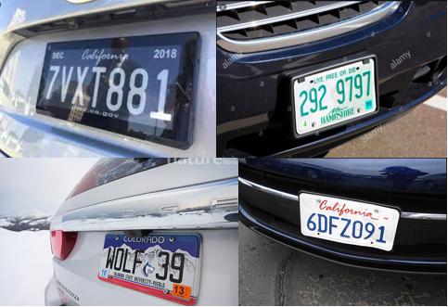
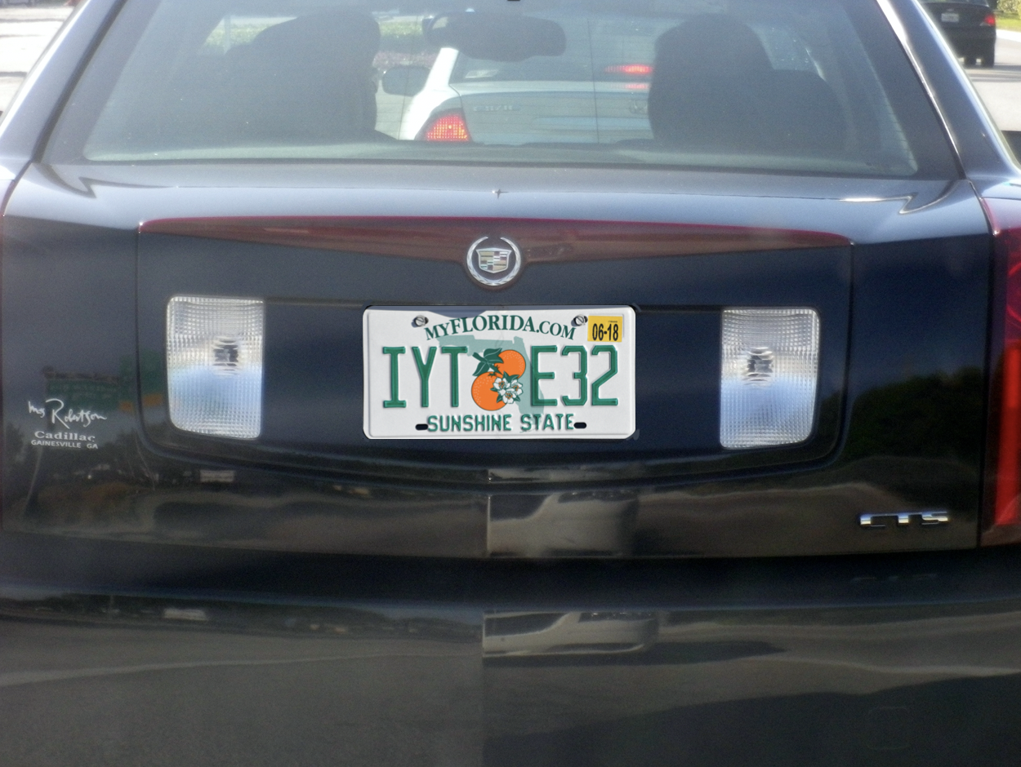
Future Work
2. Various conditions
Currently the condition we assume/restrict is that the recognition happens at the entrance/exit of a parking lot.

Slide 8
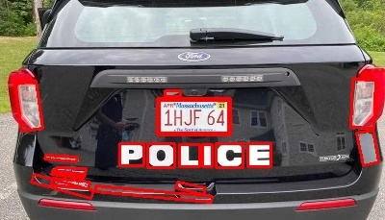
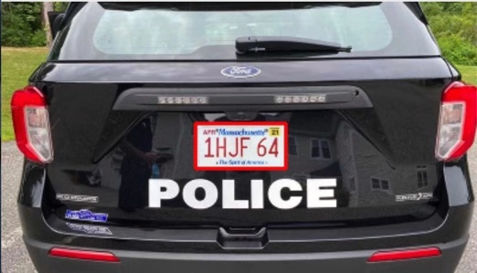
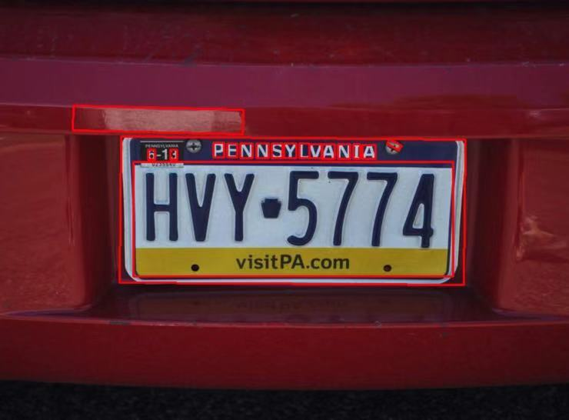
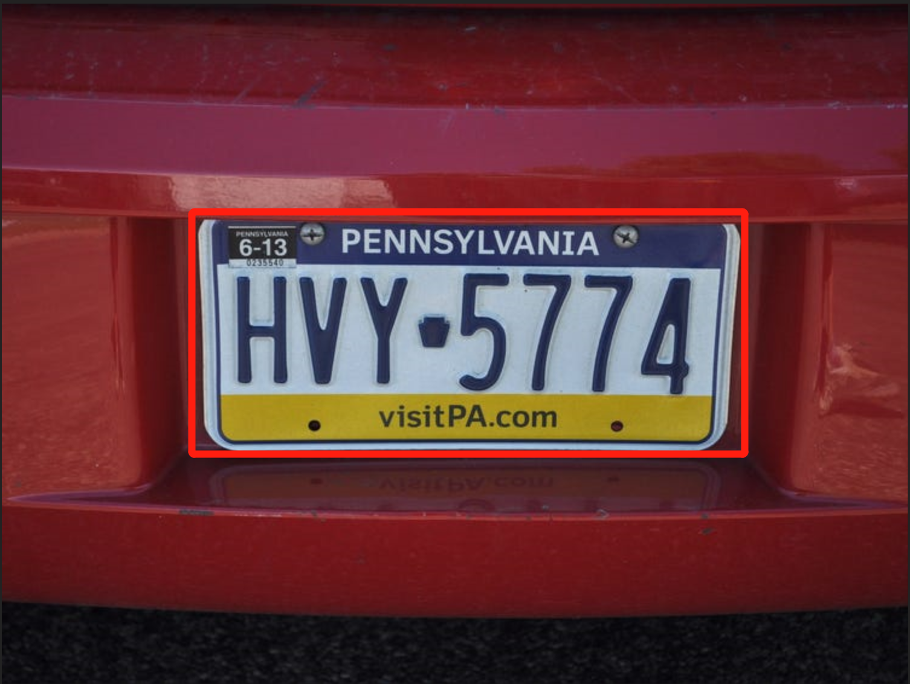
Future Work
3. More robust plate detection
We may consider using YOLO Net in the future to directly detect plate in an image

Slide 9
Future Work
4.
Currently the condition we assume/restrict is that the recognition happens at the entrance/exit of a parking lot.

Slide 10
Future Work
5.
Currently the condition we assume/restrict is that the recognition happens at the entrance/exit of a parking lot.

